Slide 1
Intelligent Sensor System for Early Prediction of
Sepsis in Neonates and High-Risk Adults
SERS-Based Detection of Bacterial Cell-Wall Biomarkers | NAM · LPS · LTA
Yearly Project Progress Review
PI: Prof. Ajay Agarwal (IIT Jodhpur) | Co-PI: Prof. (Dr.) Neeraj (AIIMS Jodhpur) | Co-PIs: TCS
Notes:
Yearly review. Narrative: reference fingerprints established for all three biomarkers, two SERS substrate generations built and validated, NAM and LTA trials completed, artifact-screening criterion established. Key remaining challenge is reproducible biomarker detection.

Slide 2
CONTEXT AND MOTIVATION
Project Background
Sepsis is a dysregulated host response to infection and a leading cause of mortality in neonates and critically ill adults.
Current diagnosis depends on blood culture (24–72 h), immunoassays and PCR — accurate but slow and infrastructure-heavy.
Host-response markers (CRP, PCT, IL-6) are faster, but only indirect indicators of infection.
SERS enables label-free, minimal-preparation detection of bacterial structural components — direct evidence of the pathogen itself.
24–72 h
Blood-culture turnaround the project aims to improve on
3
Bacterial cell-wall biomarkers targeted: NAM, LPS, LTA
785 nm
Raman excitation used throughout the study
The project targets bacterial cell-wall components rather than host-response markers, so that a positive signal is direct evidence of bacterial presence.

Slide 3
THE TECHNICAL CHALLENGE
Problem Statement
No validated, rapid, label-free platform exists for direct detection of bacterial cell-wall biomarkers within a sepsis-relevant timeframe.
Two prerequisites must be established before such a platform can be built — both were the focus of this year's work:
Prerequisite 1
Prerequisite 2
A validated Raman fingerprint library for the target biomarkers — combining DFT prediction with experimental pure-standard measurement.
A SERS-active sensing substrate, demonstrated to enhance Raman signal, before applying it to the harder problem of detecting a specific biomarker at low concentration.
Addressed this year
Substrate built and validated;
detection optimization ongoing

Slide 4
AS DEFINED IN THE PROPOSAL
Original Project Objectives
1
Biomarker Discovery
Identify bacterial biomarkers of Gram-positive and Gram-negative sepsis using Raman spectroscopy and purified components.
2
SERS-Based Sensing Technology
Develop and optimize a SERS-enabled nanosensor chip with enhanced Raman signals.
3
AI-Integrated Raman Analysis
Develop machine-learning approaches for automated Raman spectral classification.
4
Clinical Validation
Evaluate the sensor on clinical isolates and patient samples for sensitivity and specificity.
5
Point-of-Care Prototype
Integrate sensing and analysis into a portable Raman-based point-of-care system.
This year's work targets Objectives 1 and 2, and generates the structured Raman datasets that Objective 3 will later require.

Slide 5
WHERE THIS YEAR SITS IN THE FULL PROGRAMME
Overall Project Roadmap
Biomarker
characterization
DFT
modelling
Pure Raman
reference
SERS substrate
development
SERS biomarker
testing
Complete
Complete
Complete
Complete
In progress
Reproducible
detection
Bacterial isolate
validation
Clinical
validation
AI / ML
classification
Point-of-care
prototype
Next
Future
Future
Future
Future
Position after year one: the computational and experimental Raman foundation is in place and the sensing hardware exists and is validated. The programme now turns from building the capability to achieving reproducible biomarker detection — the gateway to all later phases.

Slide 6
TWELVE PROJECT AREAS
Yearly Progress at a Glance
Biomarker selection
Completed
NAM SERS
Attempted; not reproducibly detected
DFT modelling
Completed
LTA SERS
Attempted; candidate rejected as detector artifact
Pure Raman characterization
Completed
LPS SERS
Not yet performed
Raman reference library
Established for NAM, LTA and LPS
AI / ML analysis
Not started
SERS substrate fabrication
Two generations completed
Clinical validation
Not started
R6G substrate validation
Completed
Point-of-care prototype
Future stage

Slide 7
ALIGNMENT WITH THE ORIGINAL PROPOSAL
Planned Work vs. Work Completed
Original plan | Work performed | Evidence / result | Status
Raman characterization of purified NAM, LPS and LTA; build a reference spectral library | DFT Raman simulation and optimized pure-powder Raman measurement for all three biomarkers; theory-vs-experiment comparison | 51 NAM peaks matched (low RMSE); LTA composite reconstruction; LPS NNLS fit R² = 0.18 | Completed for the selected biomarkers
Develop and optimize a SERS-enabled nanosensor chip | Two Ag-coated silicon substrate generations fabricated — Sensor 1 (Ag/Si) and Sensor 2 (Ag/black-Si, MACE at 2, 5 and 10 min) | Both generations SERS-active with R6G; 2-minute etch best among Sensor 2 variants | Substrate complete; optimization ongoing
Apply the substrate to the target biomarkers | NAM SERS trials on both generations; LTA SERS trial on Sensor 2; pixel-level validation of candidate peaks | No reproducible reference-band detection; LTA 1095 cm⁻¹ candidate rejected as detector artifact; validation criterion established | Trials complete; detection pending

Slide 8
Biomarker Characterization Workflow
NAM / LPS / LTA
selected
DFT modelling
Pure Raman
measurement
Reference
spectrum
SERS testing
Gram +/- cell-wall targets
Full molecule (NAM)
Fragments (LPS, LTA)
Acquisition optimized
by SNR
Theory vs. experiment
comparison
On fabricated
substrates
Applied per biomarker
Biomarker | DFT approach | Pure Raman | Reference outcome | SERS stage
NAM | Full-molecule DFT | Optimized powder Raman (25 s, 80% power, SNR 95.91) | 51 matched peaks, low RMSE | Trials on Sensor 1 and 2
LPS | 5-fragment DFT | Optimized powder Raman (60 s, 20% power, 30 acc.) | NNLS composite fit, R² = 0.18 | Not yet performed
LTA | 3-fragment DFT | Powder Raman | Qualitative composite agreement | Trial on Sensor 2

Slide 9
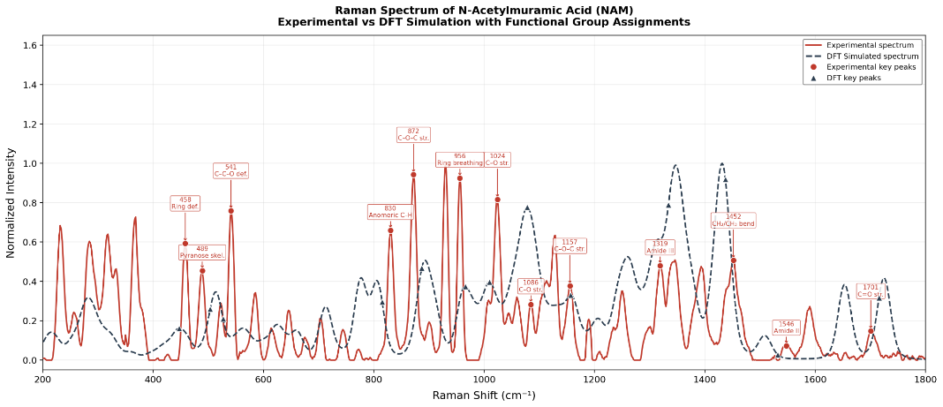
OBJECTIVE 1 · STRONGEST THEORY–EXPERIMENT AGREEMENT
NAM — DFT Modelling and Pure Raman Reference
51
peaks matched between experiment and DFT simulation, with low RMSE
NAM is specific to bacterial peptidoglycan and absent from human biomolecules.
Modelled as a complete molecule, since the Raman spectrum arises from coupled modes across the whole framework.
Acquisition optimized by SNR before the reference spectrum was fixed.
This is the validated reference against which all NAM SERS work is judged.
Experimental NAM spectrum overlaid with the DFT-simulated spectrum (full-molecule model)
Representative matched peaks — 284.3 / 282.5 (ring deformation) · 955.9 / 965.7 (ring breathing) · 1155.4 / 1156.9 (C–O–C) · 1700.7 / 1725.1 cm⁻¹ (carbonyl).

Slide 10
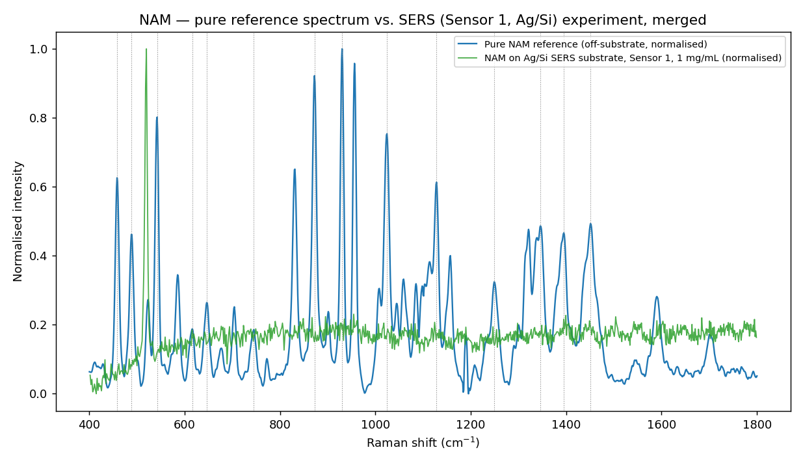
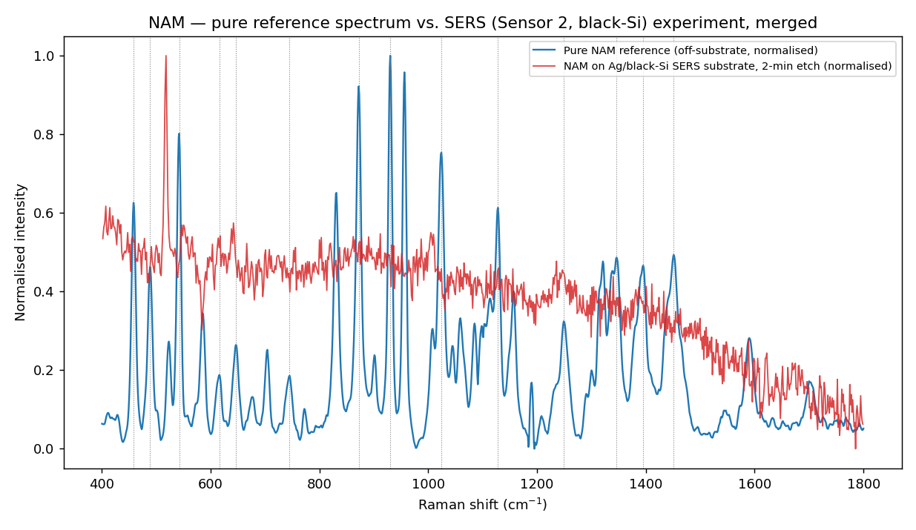
OBJECTIVE 2 · BIOMARKER DETECTION ATTEMPT
NAM — SERS Trial and Result
Merged — pure NAM reference vs. Sensor 1 SERS experiment (both normalised)
Merged — pure NAM reference vs. Sensor 2 SERS experiment (2-minute etch)
NAM SERS: attempted, but no reproducible reference-band detection was achieved. Sensor 2: no validated reference band reached SNR ≥ 3 reproducibly on any etch-time substrate.
Sensor 1 — a reproducible candidate appeared at ~243 cm⁻¹ (7/7 replicates, SNR 5.8–39). Unconfirmed — outside the 400–1800 cm⁻¹ pure-reference range, so it cannot be verified against the established NAM reference. It is not presented as NAM detection.

Slide 11
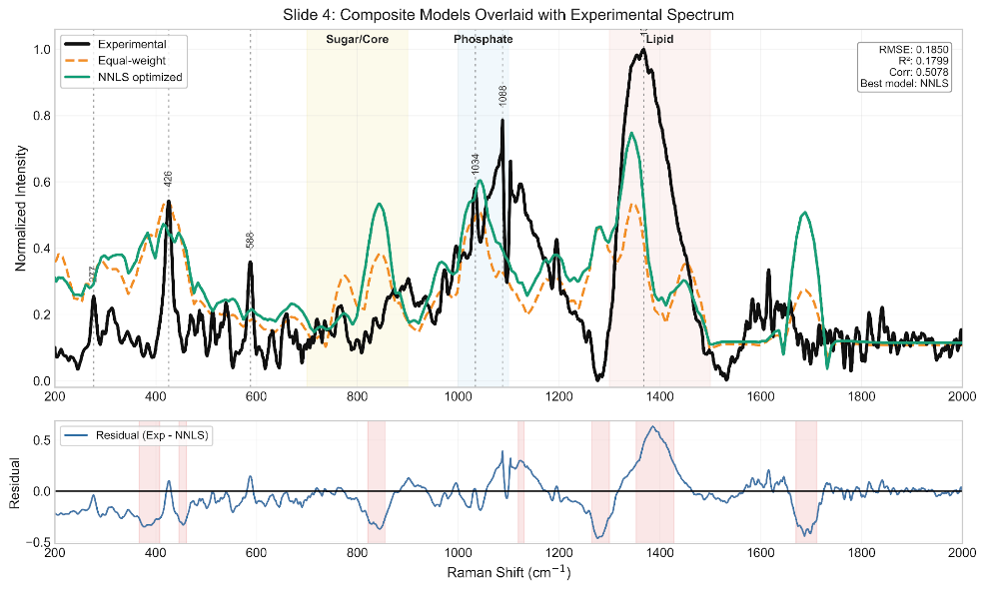
OBJECTIVE 1 · GRAM-NEGATIVE MARKER
LPS — Fragment Modelling and Pure Raman Reference
5-fragment
DFT
Pure Raman
measurement
NNLS
fitting
R² = 0.18
NNLS-optimized composite (RMSE 0.185, correlation 0.508)
Full-molecule simulation is impractical, so five representative fragments were modelled (Kdo, D-glucosamine, heptose, myristic acid, phosphoric acid).
The composite reproduces the 900–1100 cm⁻¹ sugar / ring / backbone region.
Overall fit remains moderate — consistent with LPS being a large, heterogeneous molecule poorly represented by a small fragment set.
NNLS-optimized five-fragment composite vs. experimental LPS spectrum, with residual structure

Slide 12
AN EXPERIMENT STILL TO BE PERFORMED
LPS — Current SERS Status
LPS SERS measurement has NOT YET been performed.
No LPS SERS spectrum or pure-reference-versus-SERS comparison exists at this stage. LPS SERS remains a planned next experiment, following optimization of the NAM and LTA substrate/adsorption conditions.
Pure Raman characterization
DFT / fragment modelling
Pure-reference comparison
(equal-weight and NNLS fits)
Completed
Completed
Completed
SERS — Sensor 1 (Ag/Si)
SERS — Sensor 2 (Ag/black-Si)
SERS detection
Not yet performed
Not yet performed
Planned next experiment
Not performed ≠ not detected. The LPS reference work is complete; only the SERS measurement step remains outstanding.

Slide 13
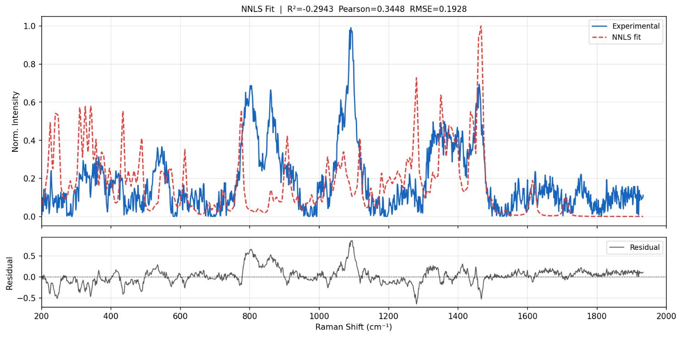
OBJECTIVE 1 · GRAM-POSITIVE MARKER
LTA — Fragment Modelling and Pure Raman Reference
3-fragment DFT
Pure Raman
Composite
reconstruction
Glycerol-phosphate backbone, D-alanine and GlcNAc modelled as representative fragments.
Agreement observed in phosphate vibrations, carbohydrate bands, CH deformation and amide-related features.
Agreement is qualitative and region-level — the three-fragment model does not capture the full polymeric architecture of LTA.
Reference established
Qualitative theory–experiment agreement via fragment modelling.
Off-substrate experimental LTA Raman spectrum vs. reconstructed theoretical (composite) spectrum

Slide 14
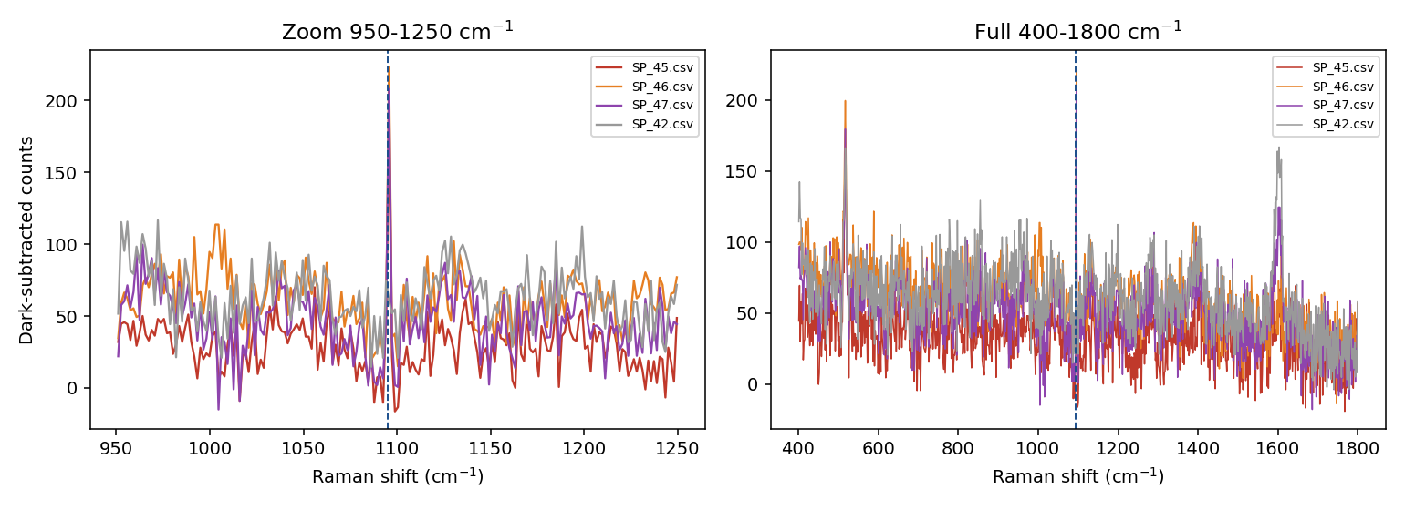
OBJECTIVE 2 · A METHODOLOGICAL ACHIEVEMENT
LTA — SERS Trial and Artifact Validation
Candidate peak
apparent feature at 1095 cm⁻¹
SNR screening
4 of 15 spots met SNR ≥ 3
Pixel-level validation
spectra inspected pixel by pixel
Single-pixel origin
Pixel-level zoom of the apparent 1095 cm⁻¹ feature (SP_45/46/47) — the signal occupies a single detector pixel
traced to one fixed detector pixel
Detector artifact
Why this matters
not a genuine Raman band
A genuine Raman band on this instrument should exhibit a multi-pixel width consistent with the instrument response, whereas a single-pixel spike is a detector artifact. Screening on this basis prevented a false-positive LTA result and produced a validation criterion now applied to all SERS peak candidates in the project.
Rejected
reclassified NOT DETECTED

Slide 15
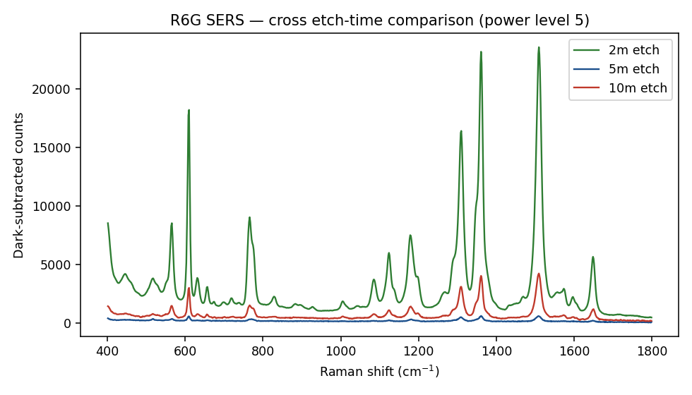
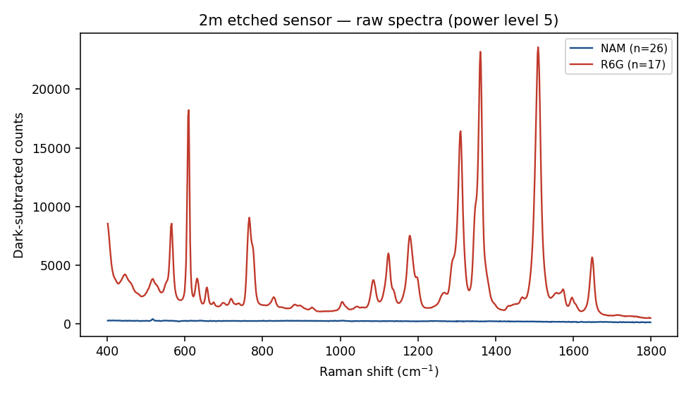
OBJECTIVE 2 · ONE CONTINUOUS DEVELOPMENT STORY
SERS Substrate Development
Sensor 1
Ag/Si
R6G
validation
Sensor 2
Ag/black-Si
Etch-time
optimization
Best condition
2-minute etch
Biomarker
trials
AgNO₃-assisted
reduction
SERS activity
confirmed
MACE with
HF + AgNO₃
2 / 5 / 10 min
compared
highest response
among variants
NAM and LTA
evaluated
R6G on Sensor 2 across the three etch times — the 2-minute substrate gives the strongest response
R6G and NAM on the best-performing 2-minute etch substrate

Slide 16
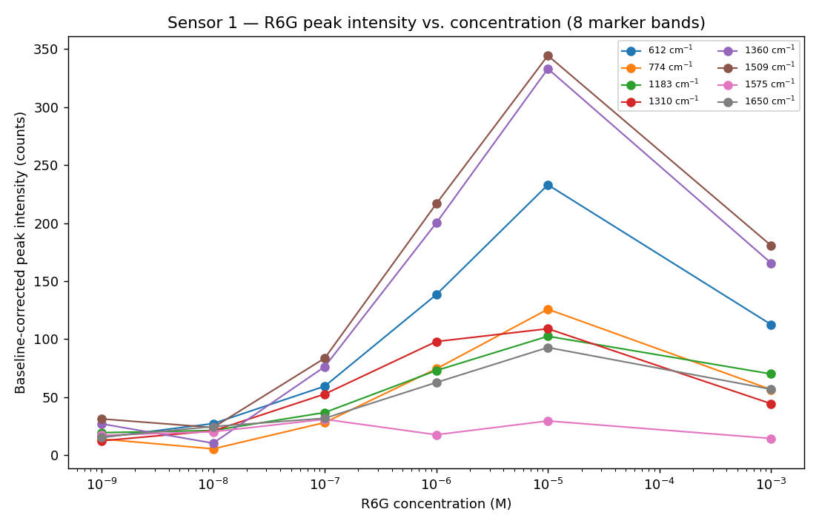
CONFIRMING THE HARDWARE WORKS, BEFORE TESTING BIOMARKERS
R6G — Substrate Validation Probe
R6G is a SERS substrate validation probe — not a sepsis biomarker. Its SERS activity confirms the substrate functions; it is not evidence of biomarker detection.
Sensor 1 — R6G concentration-response, 1 nM–1 mM
Sensor 2 — R6G response across 2, 5 and 10-minute etch substrates
Sensor 1 (Ag/Si)
Sensor 2 (Ag/black-Si, MACE)
SERS-active; measurable concentration response across the tested R6G range
SERS-active; 2-minute etch best among the three variants tested

Slide 17
EVERY SAMPLE, EVERY STAGE
Consolidated Experimental Results
Sample | Pure Raman | DFT | SERS
NAM | ✓ | ✓ | ⚠ Attempted — not reproducibly detected
LTA | ✓ | ✓ | ⚠ Attempted — candidate rejected as artifact
LPS | ✓ | ✓ | — Not yet performed
R6G (validation probe) | — | — | ✓ SERS-active on both substrate generations
✓ Completed
⚠ Attempted / in progress
— Not performed
Reading this table: the reference layer (Pure Raman + DFT) is complete for all three biomarkers. The SERS layer is where the remaining work sits — two biomarkers trialled without reproducible detection, one not yet measured.

Slide 18
WHAT THIS YEAR DELIVERED
Key Scientific Achievements
1
Three biomarkers characterized
2
DFT Raman modelling completed
3
Pure Raman reference spectra established
NAM, LPS and LTA selected and fully characterized as Gram +/- cell-wall targets.
Full-molecule model for NAM; validated fragment-based approach for LPS and LTA.
Optimized, reproducible reference spectra for all three biomarkers.
4
51 NAM peaks matched with DFT
5
Two SERS substrate generations fabricated
6
Both substrates demonstrated SERS activity
Low RMSE — the strongest theory–experiment agreement of the three biomarkers.
Sensor 1 (Ag/Si) and Sensor 2 (Ag/black-Si via MACE).
Confirmed independently using the R6G validation probe.
7
Best MACE condition identified
8
NAM and LTA SERS trials completed
9
Artifact-screening criterion established
2-minute etch outperformed the 5- and 10-minute Sensor 2 variants.
Full trials executed on the fabricated substrates.
Multi-pixel peak-width validation now applied project-wide — prevented a false positive.

Slide 19
OBJECTIVE → WORK PERFORMED → STATUS
Progress Against Original Objectives
Biomarker Discovery
DFT + optimized pure-powder Raman for NAM, LTA and LPS; theory-vs-experiment comparison
Substantially complete
1
SERS-Based Sensing Technology
Two substrate generations fabricated and validated with R6G; NAM and LTA trials completed
In progress
2
AI-Integrated Raman Analysis
Structured Raman datasets and preprocessing pipeline provide the foundation
Not started
3
Clinical Validation
Requires reproducible biomarker detection first
Not started
4
Point-of-Care Prototype
Requires validated sensing and analysis components
Future stage
5
Progress bars are indicative of stage completion, not quantitative metrics.

Slide 20
AGAINST THE FOUR PROPOSAL DELIVERABLES
Deliverable Progress
1
Raman spectral library
Reference dataset established;
expansion ongoing
Pure-standard Raman reference data established for NAM, LTA and LPS, cross-validated against DFT. Expansion to additional bacterial components continues.
2
SERS chip
Two generations fabricated and
validated; optimization ongoing
Sensor 1 (Ag/Si) and Sensor 2 (Ag/black-Si, MACE) both fabricated and confirmed SERS-active with R6G; best etch condition identified. Biomarker-level optimization continues.
3
AI-based Raman analysis algorithm
Data-generation /
preparation stage
Structured Raman datasets and a consistent preprocessing pipeline are being produced — the required input for model development in a later phase.
4
Point-of-care prototype
Future stage
Depends on validated sensing and analysis components; scheduled for a later phase of the programme.
All four deliverables are progressing along the sequence set out in the proposal; none is claimed as finished.

Slide 21
COMPLETED · IN PROGRESS · NEXT
Current Project Status
COMPLETED
IN PROGRESS
NEXT
DFT modelling — NAM, LTA, LPS
Pure Raman characterization
Reference spectra established
SERS substrate fabrication (2 generations)
R6G substrate validation
NAM SERS trial
LTA SERS trial
Artifact-screening criterion
Substrate optimization
Biomarker adsorption optimization
Measurement reproducibility improvement
Raman reference library expansion
LPS SERS measurement
Concentration-dependent NAM detection
Concentration-dependent LTA detection
Further substrate optimization
The critical path runs through reproducible biomarker detection — every later objective depends on it.

Slide 22
IMMEDIATE EXPERIMENTS VS. LATER PROJECT PHASES
Next Steps
IMMEDIATE
LATER PROJECT PHASES
Next experiments in the current work package
Sequenced after reproducible detection is achieved
1
Optimize substrate fabrication and reproducibility
Phase 2
Validation on cultured bacterial / clinical isolates
2
Optimize biomarker–surface adsorption conditions
Phase 3
Clinical patient-sample validation
3
Improve measurement reproducibility across batches
Perform LPS SERS measurement on both substrates
Phase 4
AI / ML Raman classification
4
5
Establish concentration-dependent NAM detection
Point-of-care prototype development
Phase 5
6
Establish concentration-dependent LTA detection

Slide 23
Conclusion
Established the computational and experimental Raman foundation — DFT models and pure reference spectra for NAM, LTA and LPS.
Developed and validated two generations of SERS substrates, both confirmed SERS-active using R6G.
Completed NAM and LTA SERS trials on the fabricated substrates.
Established a rigorous approach for distinguishing genuine spectral features from detector artifacts.
The key next challenge: achieving reproducible biomarker SERS detection through substrate and biomarker–surface optimization.

Slide 24
Thank You
Questions and discussion

Slide 25
Backup / Additional Results
Supporting technical detail for discussion and Q&A

Slide 26
GAUSSIAN 16
Backup — DFT Computational Parameters
Parameter | NAM (full molecule) | LTA fragments | LPS fragments
Functional | B3LYP | B3LYP | B3LYP
Basis set | 6-31+G(d,p) | 6-31G(d) | 6-31G(d)
Job type | Opt + Freq + Raman | Opt + Freq + Raman | Opt + Freq + Raman
Solvation | SMD (water) | SMD (water) | SMD (water)
Grid / SCF | UltraFine / Tight | UltraFine / Tight | UltraFine / Tight
Resources | 16 cores, 56 GB RAM | 16 cores, 56 GB RAM | 16 cores, 56 GB RAM
Pure-standard Raman acquisition
Parameter | NAM | LTA | LPS
Sample form | High-purity powder (~98%) | Powder / prepared solution | Powder / prepared solution
Excitation source | 785 nm laser | 785 nm laser | 785 nm laser
Optimum condition | 25 s integration, 80% power, best SNR = 95.91 |  | 60 s integration, 20% power, 30 accumulations

Slide 27
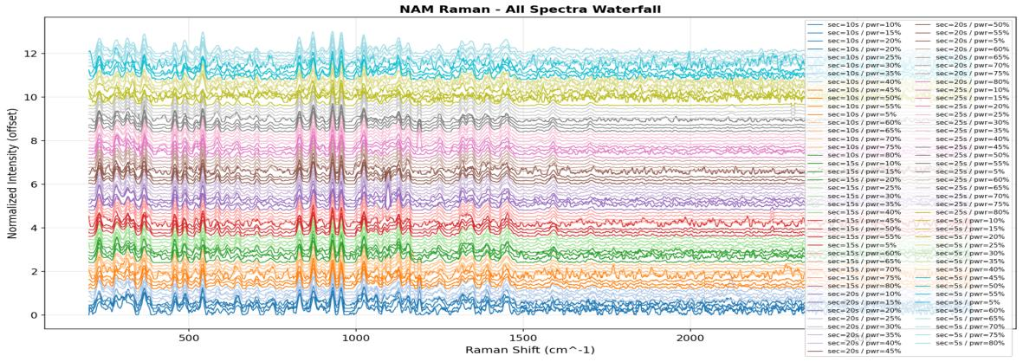
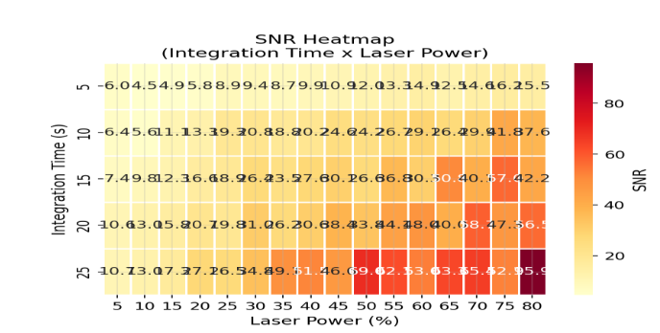
SELECTING THE REFERENCE MEASUREMENT CONDITION
Backup — NAM Acquisition Optimisation
Experimental Raman spectra of pure NAM powder across laser power / integration-time settings
SNR map across the tested parameter combinations
Selected condition: 25 s integration · 80% laser power · best SNR = 95.91 — chosen by comparing SNR across all tested combinations.

Slide 28
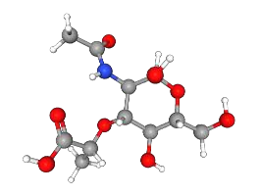
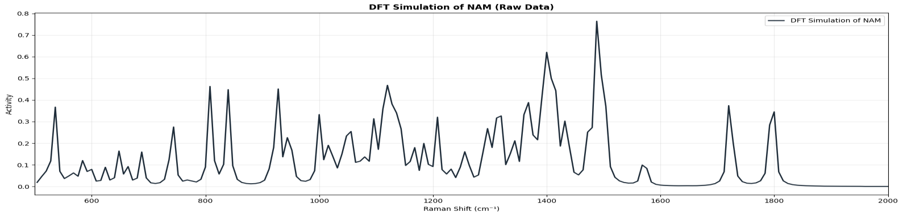
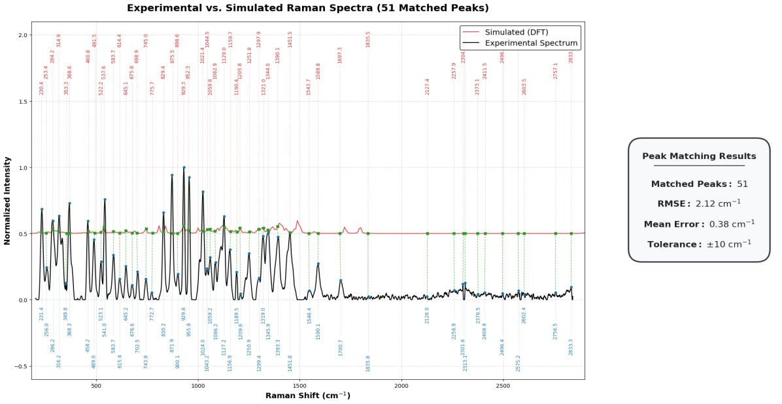
SUPPORTING DETAIL FOR OBJECTIVE 1
Backup — NAM Structure, Simulated Spectrum and Peak Matching
DFT-optimised NAM structure
DFT-simulated Raman spectrum of NAM (full-molecule model)
Representative matched peaks (6 of 51)
Experimental (cm⁻¹) | Simulated (cm⁻¹) | Assignment
284.3 | 282.5 | Ring deformation
772.7 | 777.8 | Ring vibration
955.9 | 965.7 | Ring breathing
1155.4 | 1156.9 | C–O–C stretching
1345.9 | 1347.4 | CH deformation
1700.7 | 1725.1 | Carbonyl stretching
Peak-matching and error analysis — 51 matched peaks

Slide 29
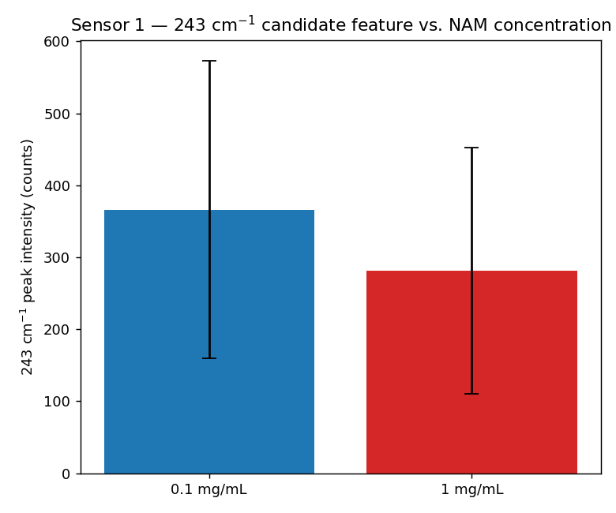
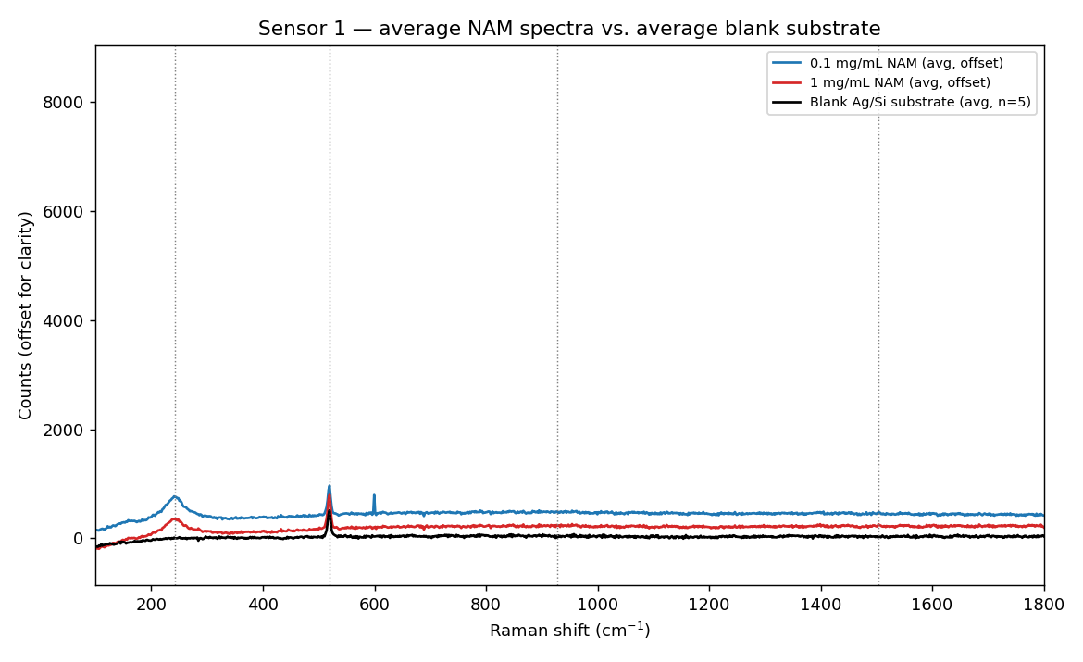
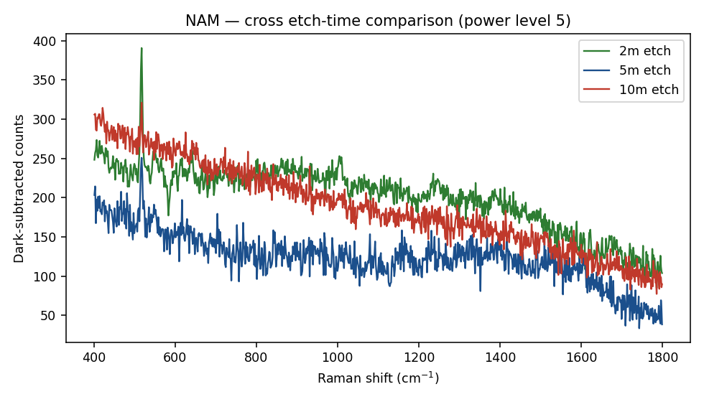
SENSOR 1 AND SENSOR 2
Backup — NAM SERS Trial Detail
NAM (1 mg/mL) on Sensor 1 vs. blank-substrate spectrum
~243 cm⁻¹ candidate peak intensity vs. NAM concentration (mean ± SD)
NAM on Sensor 2 across 2, 5 and 10-minute etch substrates
Substrate | Result
Sensor 1 (Ag/Si) | One reproducible, tentative candidate at ~243 cm⁻¹ (7/7 replicates), outside the range covered by the pure reference spectrum and therefore not confirmable against it. Weaker candidates near 928 and 1504 cm⁻¹ (SNR ≈ 1–3) were not accepted.
Sensor 2 (Ag/black-Si, MACE) | No validated NAM reference band reached SNR ≥ 3 reproducibly on any etch-time substrate, at either laser power, raw or blank-subtracted.
Contributing factors | Low intrinsic Raman scattering strength · weak or non-specific adsorption onto the silver surface · competition with background adsorption · concentration dependence · difference between a purified compound and the same motif within a bacterial cell wall.

Slide 30
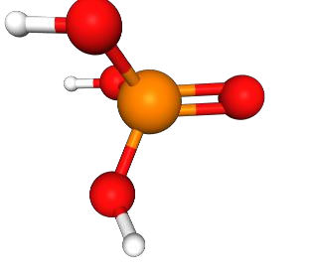
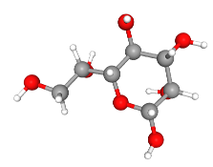
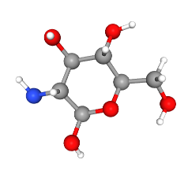
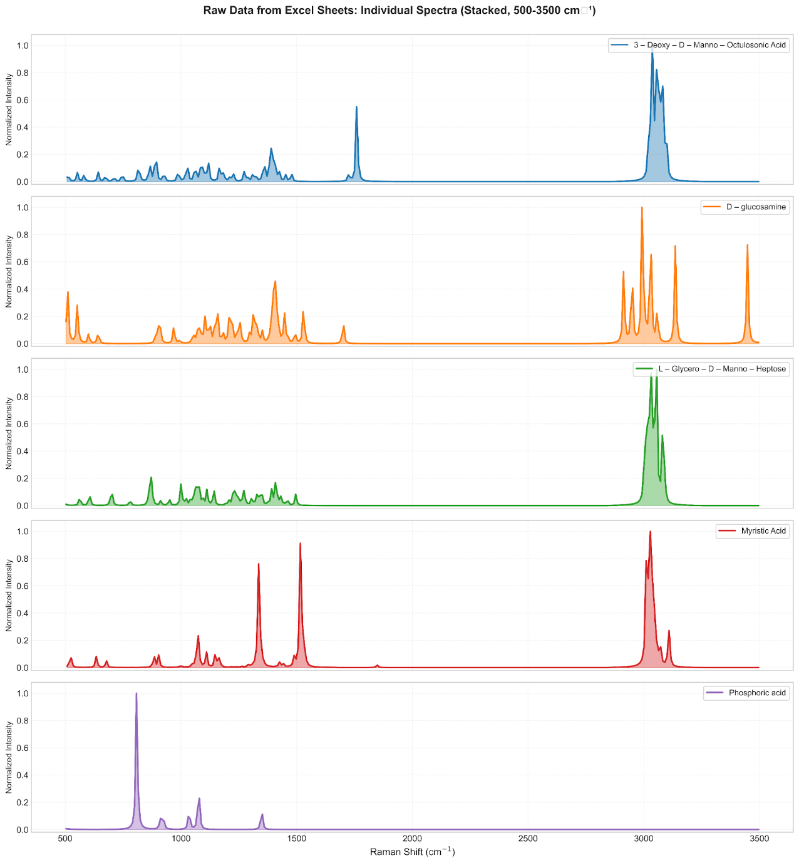
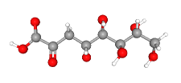

FIVE-FRAGMENT DFT APPROACH
Backup — LPS Fragment Models and Simulated Spectra
(a) Kdo
(b)
(c)
(d)
(e)
(a) Kdo, identified in the report; (b)–(e) the four further fragments — D-glucosamine, L-glycero-D-manno-heptose, myristic acid and phosphoric acid — shown as a set, as in the source report.
Optimized fragment contributions (NNLS)
Fragment | Contribution (%)
Kdo | 47.3
Heptose | 25.8
D-glucosamine | 15.3
Myristic acid | 11.7
Phosphoric acid | 0.0
Simulated Raman spectra of the five LPS fragments (normalised, 500–3500 cm⁻¹)

Slide 31
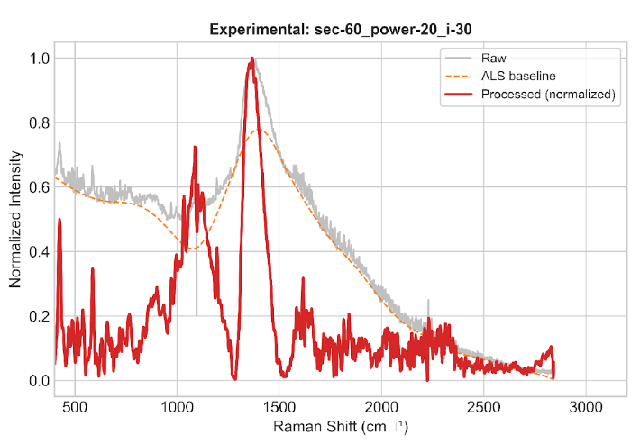
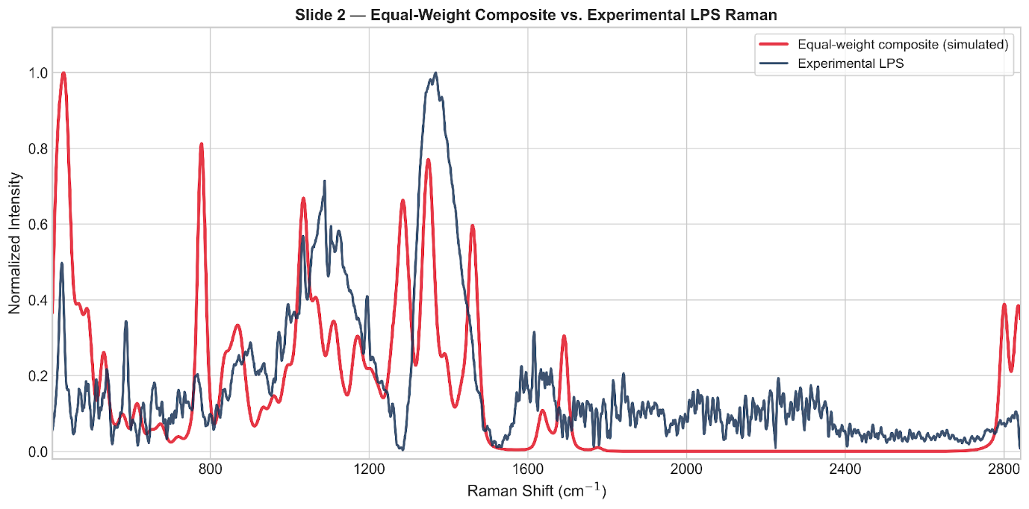
EQUAL-WEIGHT VS. NNLS-OPTIMIZED
Backup — LPS Experimental Spectrum and Composite Fits
Experimental LPS powder spectrum (60 s, 20% power, 30 accumulations)
Equal-weight five-fragment composite vs. experimental LPS spectrum
Model fit quality
Model | RMSE | R² | Correlation
Equal weight | 0.189 | 0.149 | 0.417
NNLS optimized | 0.185 | 0.180 | 0.508
The NNLS composite reproduces the 900–1100 cm⁻¹ sugar/ring/backbone region; the overall fit remains moderate (R² = 0.18), consistent with LPS being a large, heterogeneous molecule poorly represented by a small fragment set.

Slide 32
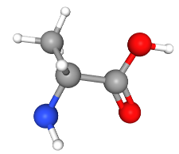
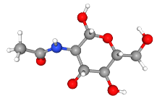
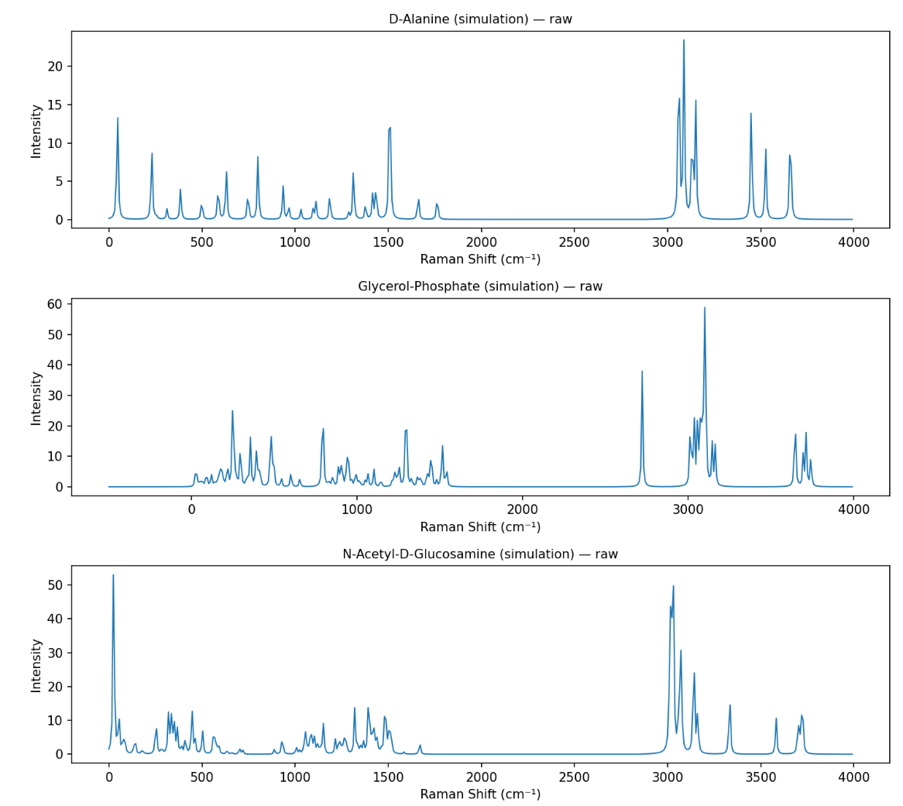
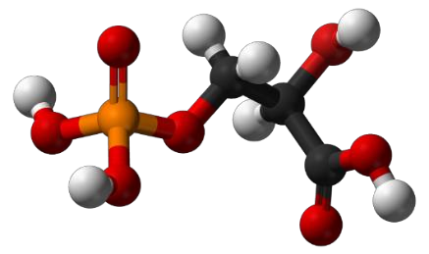
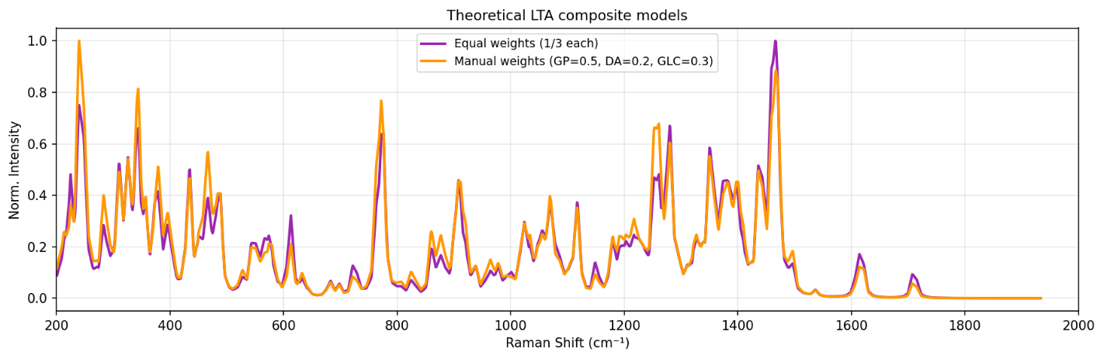
THREE-FRAGMENT DFT APPROACH
Backup — LTA Fragment Models and Composite Spectrum
(a) Glycerol-phosphate backbone
(b) D-alanine substituent
(c) GlcNAc substituent
(d) Simulated spectra of the three LTA fragments
Component | Approximate contribution
Glycerol-phosphate | 20–25%
D-alanine | 34–40%
GlcNAc | 40–43%
Fragment weighting in the composite theoretical LTA spectrum
(e) Weighted composite theoretical LTA spectrum

Slide 33
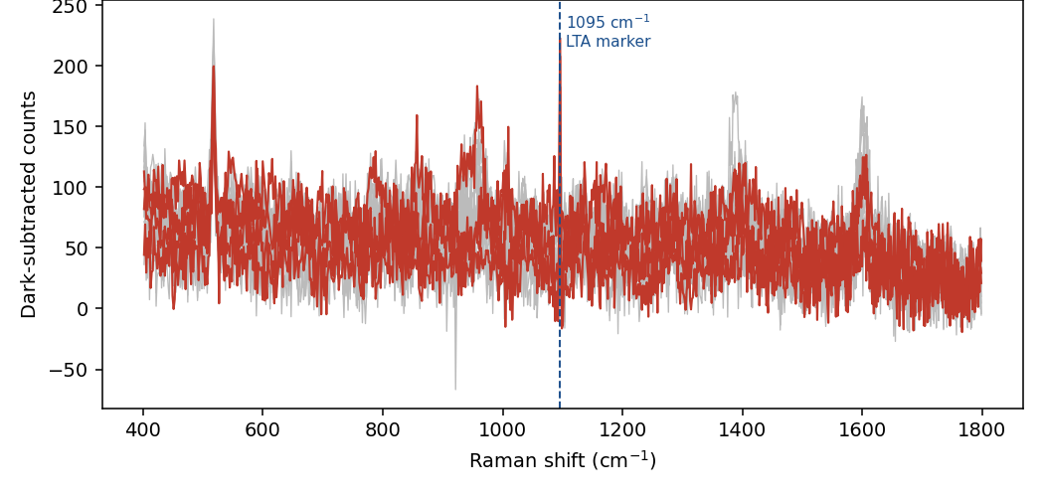
SENSOR 2, 2-MINUTE ETCH
Backup — LTA SERS Trial, All Measurement Spots
Peak-validation methodology
SNR acceptance threshold
A minimum SNR of 3, reproducible across replicate spots, is required for a candidate SERS peak to be accepted.
Peak-width validity
A genuine Raman band should exhibit a multi-pixel width consistent with the instrument response; a single-pixel spike is treated as a detector artifact.
Applied consistently
Established from the LTA investigation and applied to all subsequent SERS peak validation.
LTA on Sensor 2 (2-minute etch) — all 15 measurement spots overlaid
Outcome: the apparent 1095 cm⁻¹ feature (4 of 15 spots at SNR ≥ 3) failed the peak-width criterion and was rejected as a detector artifact.

Slide 34
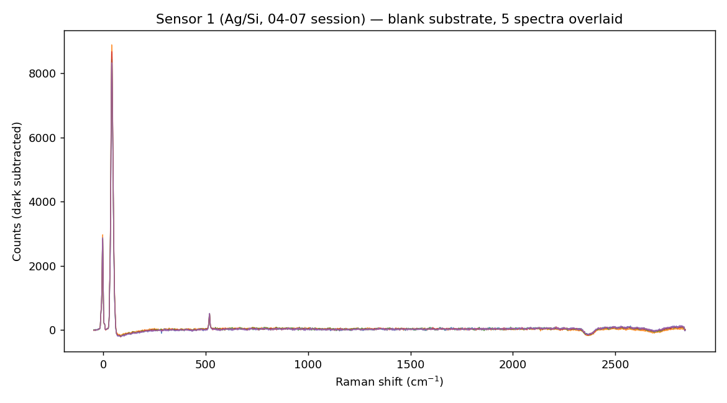
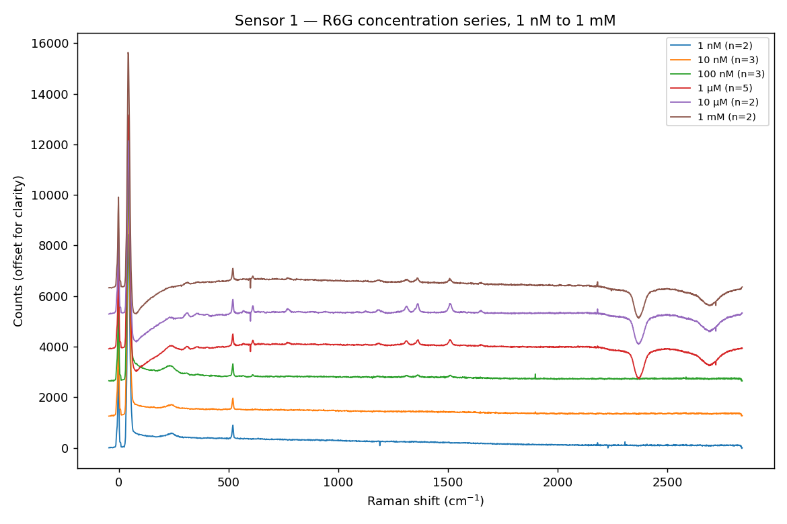
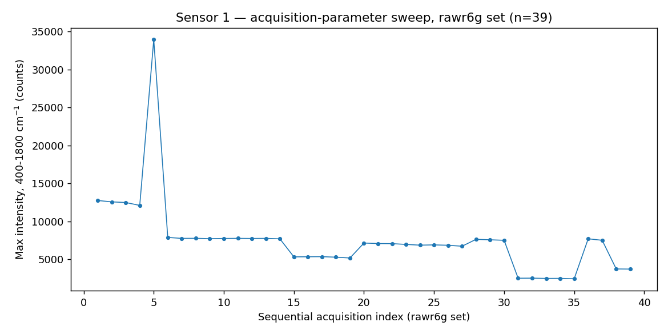
BLANK, CONCENTRATION SERIES AND REPRODUCIBILITY
Backup — Sensor 1 (Ag/Si) R6G Validation Detail
Blank substrate — five spectra overlaid
R6G concentration-response, 1 nM–1 mM
R6G concentration series (stacked)
Outcome
Sensor 1 demonstrated SERS activity and a measurable concentration response across the tested R6G range.
Blank-substrate spectra established the background baseline used for all subsequent subtraction.
The 39-spectrum sweep provided the reproducibility reference for the substrate.
39-spectrum acquisition sweep used for reproducibility assessment

Slide 35
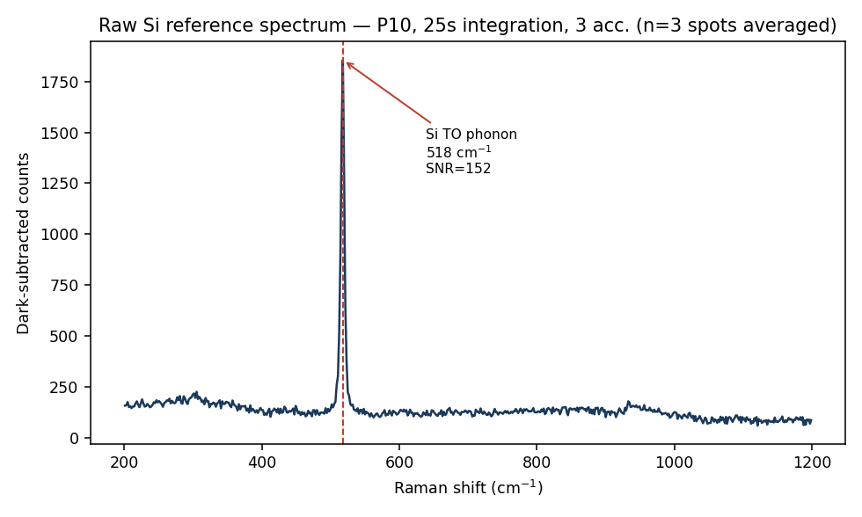
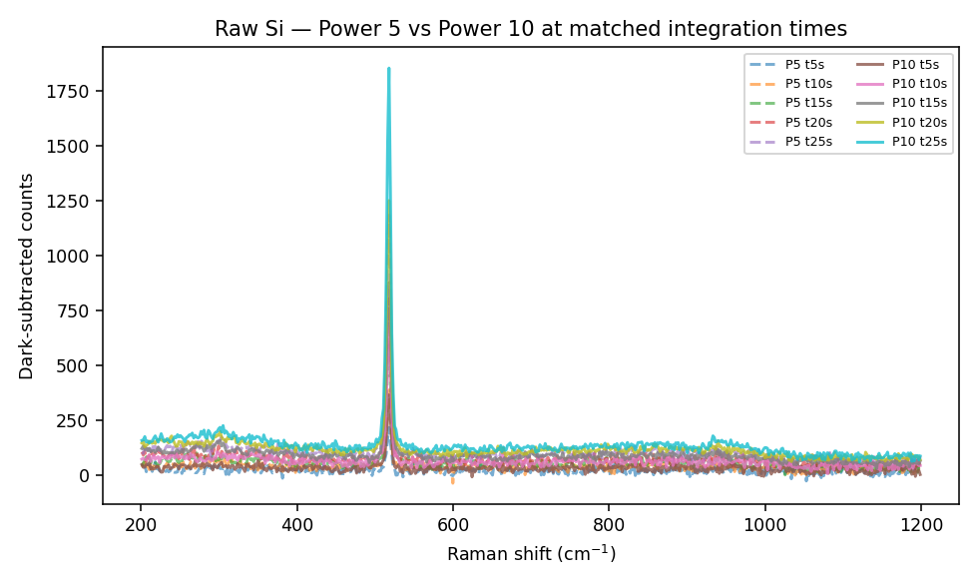
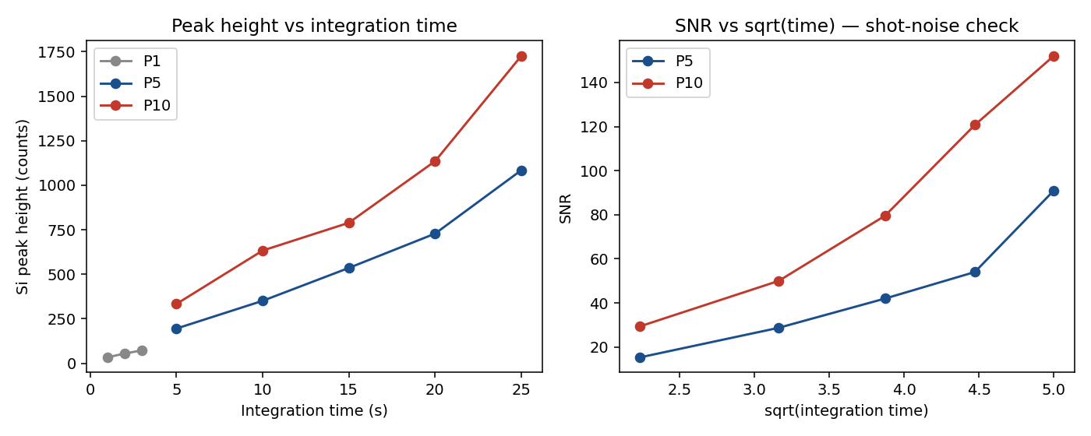
INSTRUMENT REFERENCE MEASUREMENTS
Backup — Raw-Silicon Reference and Wavenumber Calibration
Unetched-silicon reference spectrum (highest-signal condition)
Unetched-silicon spectra across tested laser power settings
Linearity check of the silicon 520 cm⁻¹ phonon reference peak
Purpose: unetched raw-silicon spectra provide the wavenumber calibration reference for the instrument and establish its minimum resolvable peak width — the basis for the multi-pixel peak-validity criterion applied to all SERS candidate peaks in this project.

Slide 36
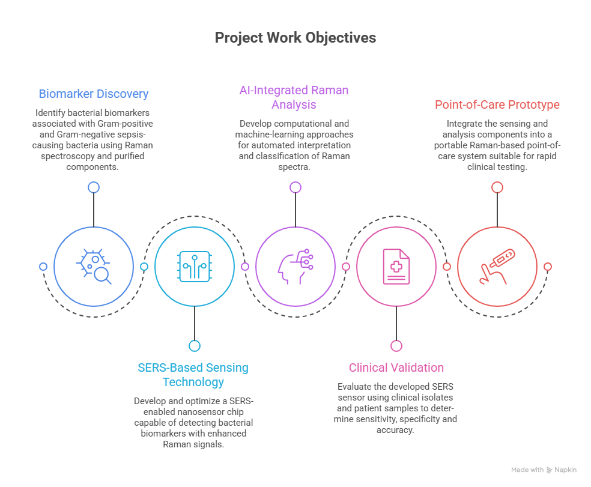
AS PRESENTED IN THE PROJECT REPORT
Backup — Project Objectives (Original Proposal Figure)
Objective summary
Biomarker Discovery
1
SERS-Based Sensing Technology
2
AI-Integrated Raman Analysis
3
Clinical Validation
4
Point-of-Care Prototype
5
Graphical representation of the project objectives

